Slide 1
The power of language!
Leading Together Festival

Slide 2

Welcome from
Danny Bowyer
Sharon Gilfoyle
Emma Taylor
Jamie Willo
Neema Young
Temi Eniola
Melanie Urbain-Grainger

Slide 3
Danny Recovery Language
Recovery focused language may be different to what we are used to
Person first language
Less focus on medical language, diagnosis and symptoms
More focus on strengths rather than challenges
Avoid use of language as a sounding off mechanism, ‘terminology of madness’
Considers people they work alongside ‘people’ not just a ‘patient’ or someone on their caseload
Is a way of speaking that is person-centred, hopeful, non-stigmatising

Slide 4
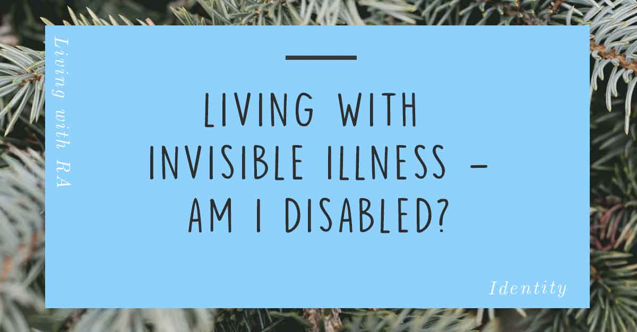

Slide 5

Sharon Disability Language
I have a number of long-term conditions
Am I disabled or do I have a disability?
Completing forms and ESR
Stigma and self- stigma

Slide 6
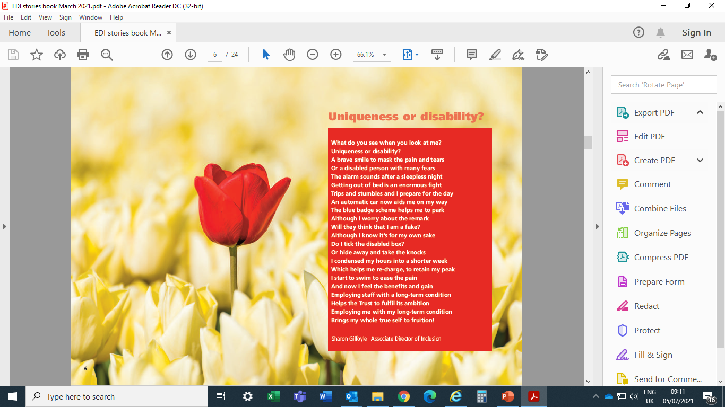

Slide 7
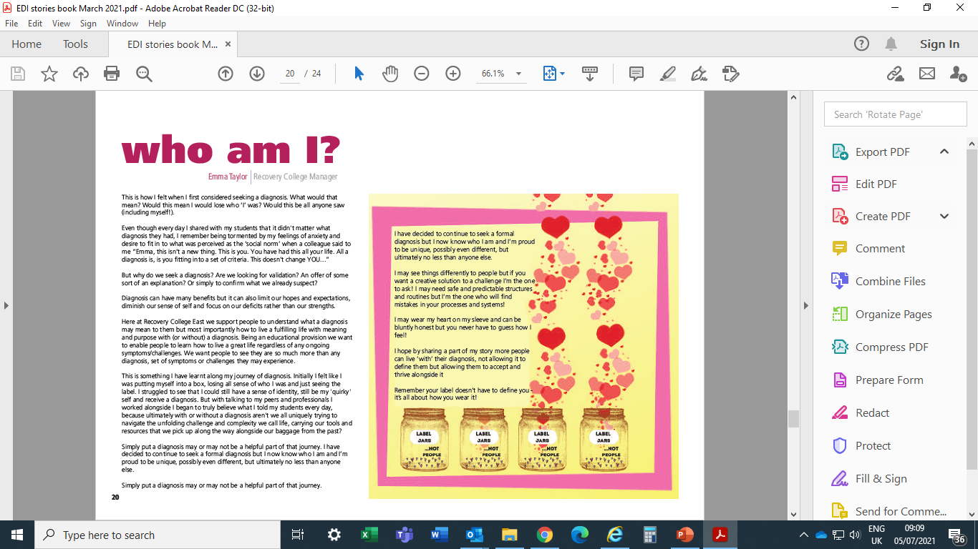
Emma

Slide 8
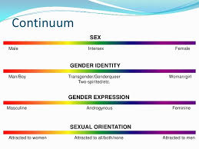
Jamie
Inclusive Language for Gender Identity and Sexuality
Inclusive language
Our society
Terminology
Pronouns
LGBTQ+ Allies

Slide 9

Neema and Temi the language of race

Slide 10
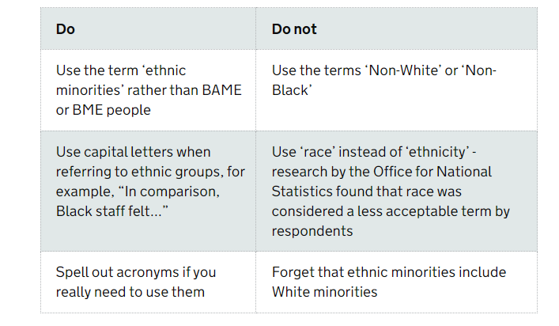
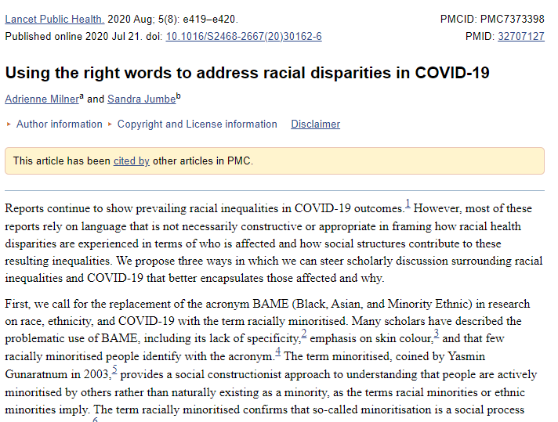
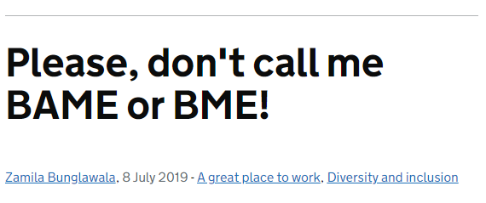
Notes:
Every so often Language and different terms change. Race is inked with physical characteristics, and ethnicity is associated with cultural identification and background .Blakemore, Erin (2019) ‘Race and ethnicity: How are they different?’, National Geographic, 22 February 2019

Slide 11


Microaggression
Microaggression is a comment or gesture (whether made intentionally or not) that feeds into stereotypes or negative assumptions created around oppressed or marginalized groups of people.
It does not only affect race or ethnicity it includes comments about religion, gender, sexual orientation, appearance or disability.
This Photo by Unknown Author is licensed under CC BY-SA-NC
This Photo by Unknown Author is licensed under CC BY-NC-ND

Slide 12
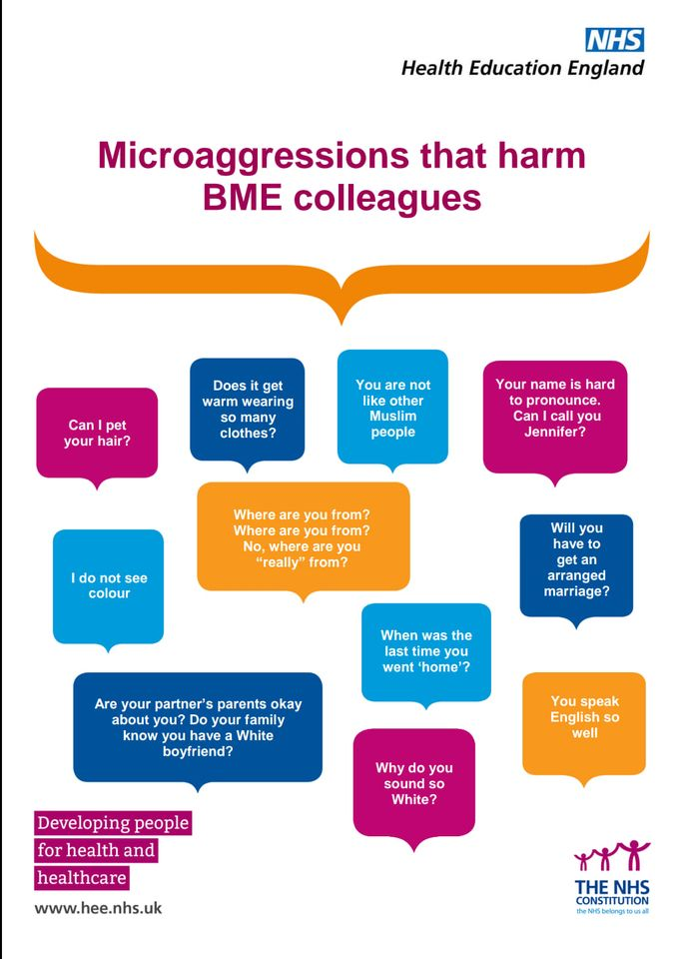
Microaggression -why does it matter?
It is important to pay attention to how we talk. For example :
You're so articulate.“ “You speak so well”
"You don't look transgender."
"Your name is hard to pronounce. Can I call you this instead?“
"You're Asian? You should meet my one Chinese friend. You all may know each other.“
"Is that your real hair? Can I touch it?“
"I'm colorblind. I don't see color.“
Wow, you don't look like it at all’
‘ You don’t act like a normal black person’.
Microaggressions are so subtle, it is often hard to know if you're committing one or if you're on the receiving end.
Who does it affect?
It affects people from marginalized communities, gender, age or people with disabilities

Slide 13
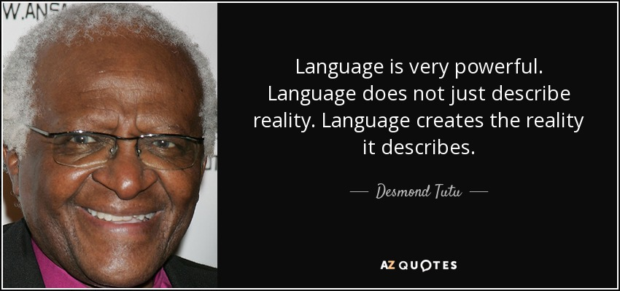
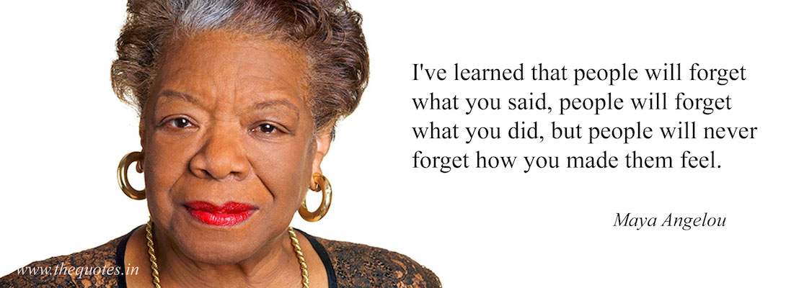
The impact of microaggressions on individuals:
According to Psychologists repeated comments can affect the mental and physical health of an individual and make people doubt themselves.
How to stop Micro-aggressions
Stop and think about what you’re about to saying
Listen and try understand the other person who has been offended
Educate yourself and speak up against any forms of microaggressions

Slide 14

Over to Mel for questions

Slide 15
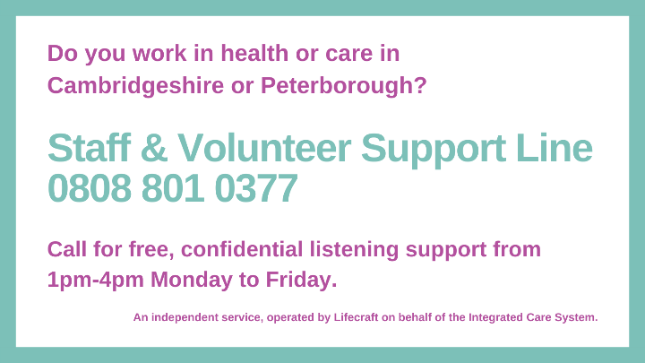

We know life is stressful right now. We are here for you.
If you work in healthcare, social care, the voluntary sector or not-for-profit sector in Cambridgeshire or Peterborough and need someone to talk to, we are here for you. ​
You can call us in complete confidence to talk through any problems you’re facing, whatever they may be.
​
The Staff & Volunteer Support Hub is separate to employee assistance programmes. It’s an overarching service which aims to make sure you can quickly get the right help for you, when you need it.
Not in a formal volunteering role? Support is available through:
Samaritans – Call 116 123 (for free), available 24 hours a day everyday.
Lifeline - Cambridgeshire and Peterborough Mental Health Helpline FREEPHONE 0808 808 2121
available 11-11 everyday.
Notes:
Cambridgeshire and Peterborough Integrated Care System, in partnership with CPFT, have launched a new support service in response to the pandemic, specifically for people who work in healthcare, social care, the voluntary sector or not-for-profit sector in Cambridgeshire and Peterborough. It is also available if you work in a Cambridgeshire or Peterborough organisation, but your work base is elsewhere.
The pandemic has affected us all in different ways, some of us are juggling working from home with caring responsibilities, some are feeling overwhelmed at work or at home, some are stressed because of financial problems, some may be anxious every time they hear an update on the news, some are feeling the strain of isolation and some may be struggling to mentally recover from COVID-19 or the loss of a loved one. Some of us may just feel down or a bit less bright, but we aren’t sure why.
The Staff Support Hub has been set up to support all workers, clinical and non-clinical, across health and social care, primary care and voluntary services, whether you work directly with patients or not. So, if you work within the NHS, a GP practice, in a care home, in adult or children’s social care or in the voluntary sector, you can call us.
The Staff Support Hub is run by experts in the mental health field and confidentiality is paramount. Whether you need to talk to somebody, seek advice on where to find specific resources, receive counselling, attend a group session or organise a team debrief from a particular situation, the Staff Support Hub is here for you.

