Slide 1

Joining in the conversation
@AndreaGrosbois
Head of Communications
and Engagement

Slide 2
What do you want to get out of today’s session?

Slide 3
Network
Get up-to-date
Join in
Social media - why bother?
Become an ambassador
Social
Share team success stories/advice/ developments /events
Best practice
Gather opinions to shape your service – public engagement

Slide 4
The stats
4.2 billion social media users in the world – 54% of the world’s population
On average people spend 2hours 25minutes on social media each day (aged 16-64)
Facebook – 2.18 billion global users - still most used platform in the world! 66% of UK adult population use Facebook
People aged 65+ are the fastest growing demographic, but 61.3% of users are under 35
YouTube – 2nd most popular with 2billion users globally and 1 billion hours consumed daily
Instagram – 31 million users in the UK
LinkedIn – Ads now have potential to reach 56% of UK adult population
Twitter – 353 million global users (16.5million UK) – 44% have never sent a tweet
63% of all Twitter users are between 35-65 - 25% of Twitter users are journalists
Pinterest – 200 million global users – 44% are aged 25-44
TikTok – fairly new but already 7th most active social media app in the world. 3.7million UK users (predicted to grow to 10million by end of 2021) most popular with Gen Z (13-20year olds)
WhatsApp – most popular messenger app in UK – 3rd largest networking channel in the world
Facebook Messenger – 30million users in the UK
Snapchat – 21 million users in the UK – 59% of users are under 24

Slide 5
Which channels to use?
Facebook
Good for sharing events/news
Can create pages/groups
Great if you want people to share your posts/share others
Twitter
Good for sharing snippets of info
Good for Gifs/photos / videos
Retweeting
Hashtag based – link in with trending items to boost your post
Instagram
Photo/video based sharing
Engagement and success of post is down to how compelling the content is – need to share images regularly
Hashtag based similar to Twitter
LinkedIn
‘Formal’ social media channel
Good for jobs, recruiting, training
More workforce/ company promoting platform
Not great for sharing Gifs, videos, hashtags etc
YouTube
Video sharing platform
Not good for events, vacancies or starting conversations

Slide 6
Social media-isms
Content – ways of sharing information e.g. text/pictures/videos/Gifs /threads/ polls/live sessions/stories
Tweet/post – Status update – can be text/picture/video/Gif
Follower – Someone who subscribes to see your posts in their newsfeed
@ – Using @ before a persons social media name lets them know that you have written to them e.g. “@JohnSmith great game last night!” would give John Smith a notification to say you’ve mentioned him
# - A hashtag is a way of linking messages to a topic e.g. when we Tweet about jobs we will include #NHSjobs #vacancies so people who are looking for jobs see our Tweet when they search those terms
Retweet/Repost – This means you are sharing someone else’s post on your profile page. If you do ‘quote tweet’ you can add comments
Like – You can click the heart icon to let someone know you support or agree with their Tweet.
Gif – This is a moving picture from an online library
Reply/comment – You can reply to someone else’s post. This will show up under their post and be visible to those who follow them or everyone if they have a public profile
DM/PM – Send a private message to another individual/select group of people

Slide 7
Things to consider when creating content
Would you be interested in your own content?
Is it engaging?
Does the post have a target audience?
Is the tone right?
Is it too wordy/long? Does it contain too much jargon?
Is it appropriate to post at this time? (mindful of world events/ trends)
Different platforms require different content
Any relevant hashtags/trending tags that I can use?
Proof read!

Slide 8
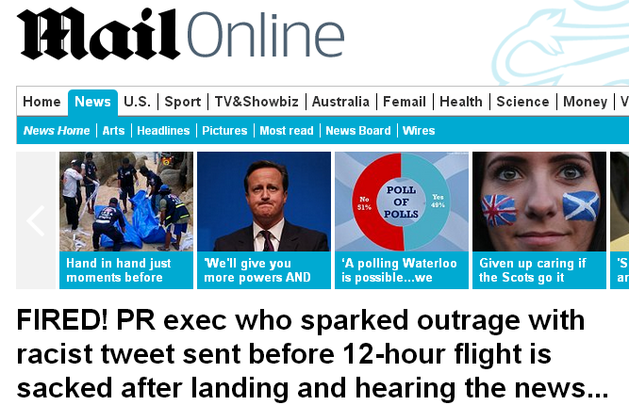
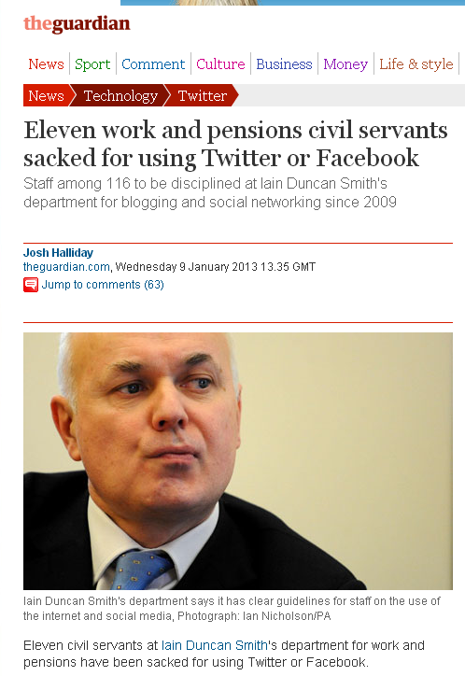
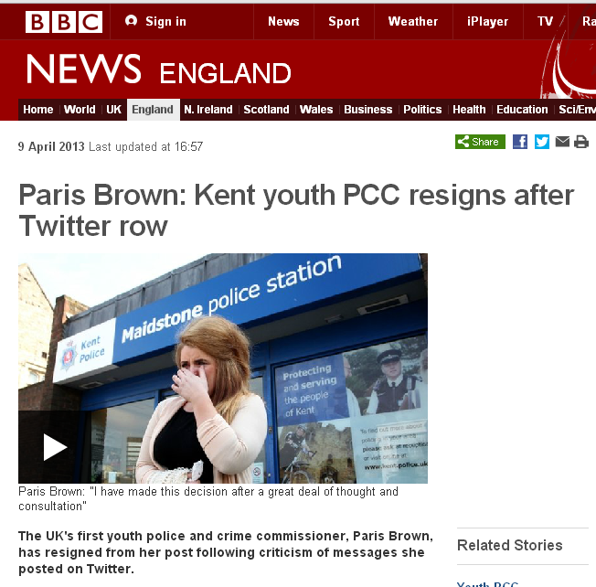

Slide 9
So… think before you hit ‘publish’
Who can see my post? If you have a public profile… everyone.
“Join in the conversation at #XFactor”
Anything you Tweet with #XFactor could then be posted on the TV in one of the ad breaks.
Journalists are also known to include posts/photos/information from public social media accounts in their articles.
CPFT has a social media policy for staff (worth a read!) key highlights:
You are responsible for your own online content
Don’t post images/videos of staff/patients/carers without consent
Don’t post or comment on anything considered confidential/offensive/ inappropriate
Don’t follow or ‘friend’ patients
Ask permission if sharing images/music that may be copyrighted/ trademarked etc (check with comms if you’re unsure)

Slide 10
Things to consider
Privacy settings – who & what can people see on your profile?
Where will my messages go? Who can use them?
Who am I following? Is it appropriate?
What conversations am I joining in?
What am I liking/retweeting/responding to?
Employers often look at online reputation in pre-employment checks – over ¾ of UK employers check social media accounts as part of screening process & 36% of employers rejected candidates based on their social media
Check out your professional body & CPFT social media guidance
If someone posts something abusive/offensive/breaches confidentiality on your profile you can report it/hide/delete the comment.
Talk to us if you’re ever unsure or need help!
Patients may also contact you on Twitter. Don’t enter discussions in the public domain, instead ask them to get in touch privately or signpost to pals@cpft.nhs.uk

Slide 11
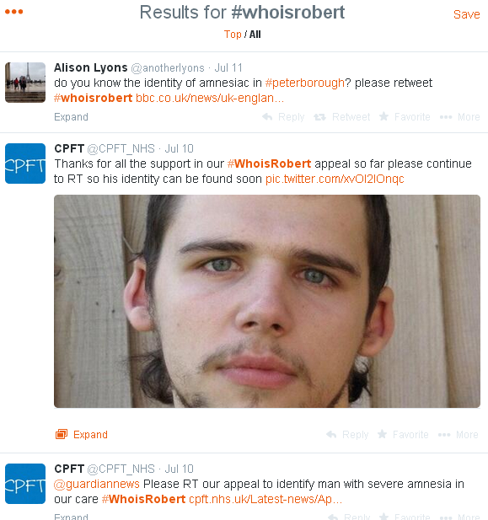
It’s not all doom and gloom…

Slide 12
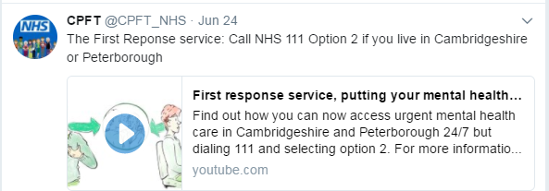
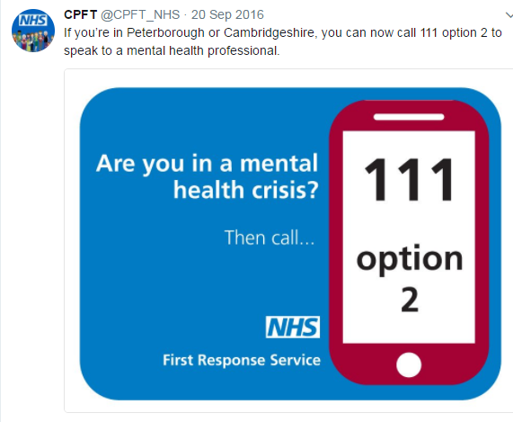
Over 300,000 people watched our animation via social media in a month

Slide 13
Sharing your team’s achievements
You can either:
Be your team’s ambassador and copy in @CPFT_NHS so we can retweet/like/share to boost the post views
You can send your content, pictures, videos, stories to us to share from CPFT channels including internal staff channels communications@cpft.nhs.uk
If you want to set up a team account please talk to us first and we can help you:
Come up with a plan for how it will be managed and updated
Talk through potential pitfalls
Discuss accessibility requirements – captions for photos, video subtitles and transcripts etc.
There is guidance and a Social Media Request Form on the intranet.

Slide 14
Follow us and join in the conversation at:
@CPFT_NHS
@CPFT_Research
@head2toecharity
@CPFT_NHSJobs
More resources available on the intranet or contact us via communications@cpft.nhs.uk
We’re here to support you!

Slide 15
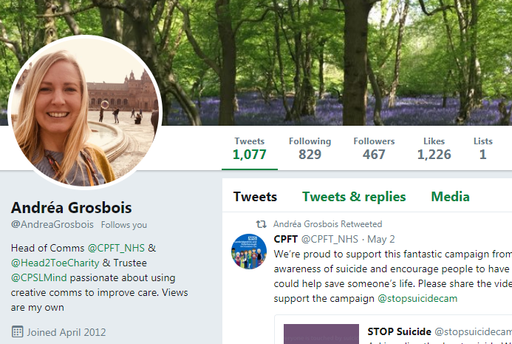
Twitter - Getting set up
@somethingsensible
Introduce who you are in the bio
Real photo
Follow @CPFT_NHS
Check your privacy settings

Slide 16
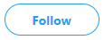
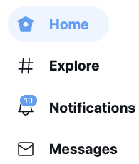
Navigating your Twitter
Subscribing to someone’s tweets so you can read and receive them
Newsfeed where you can see tweets from people you follow in the order they happen
Popular stuff people are tweeting about or ‘trending’
When people interact with your tweets/follow you/highlighting what you might be interested in
Direct message that only you and the other person can see

Slide 17
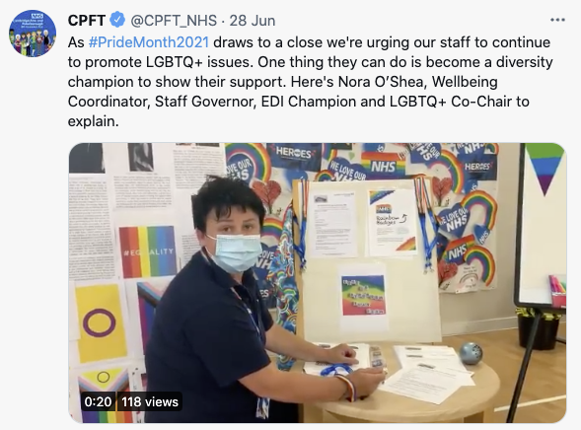
Joining in on Twitter
Reply
Retweet
Like
Share – Direct Message/ add to bookmarks/copy link

Slide 18
How to shorten a long url
Twitter only allows a certain number of characters in each post so adding long urls (website links) can eat into your post space!
There are a number of websites that can shorten urls for you – I tend to use www.tinyurl.com
For example if I wanted to put a post promoting a opportunities for patient and carer involvement in research at CPFT the full link would be:
https://www.cpft.nhs.uk/service-user-and-carer-involvement
If I pop it into the tiny url website (free and easy to do, no sign up required) it comes out as:
https://tinyurl.com/5dtphb47
This new link still takes you there but in a shorter way – good for posters too!

